Slide 1






Scenarios Game (Game 2)

Slide 2
Household
Questions

Slide 3
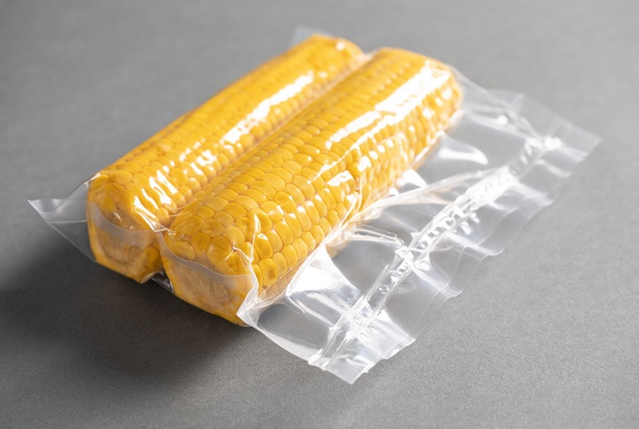

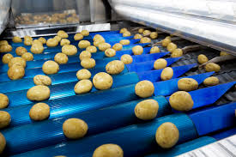
Food irradiation is the process of exposing foodstuffs to gamma rays to kill bacteria that can cause food-borne disease, and to increase shelf-life.
Which radionuclide would you use for this purpose and why?

Slide 4



5 points
3 points
1 points
Cobalt-60
Caesium-137
Iron-55
Nickel-63
Iridium-192
Promethium-147
Notes:
Cobalt-60 and Caesium-137 are recognised food irradiation radionuclides.
Iron-55 and Nickel-63 emit high energy gamma radiation but Fe-55 has a shorter-than-ideal half life and Ni-63 has a longer-than-deal half life
Iridium-192 and promethium-147 emit gamma radiation so can be used for this purpose but are expensive
Ideal radionuclides must: be solid, emit gamma radiation, have a suitable half life (timescale of years), have a low cost and not be poisonous (e.g. lead!).

Slide 5
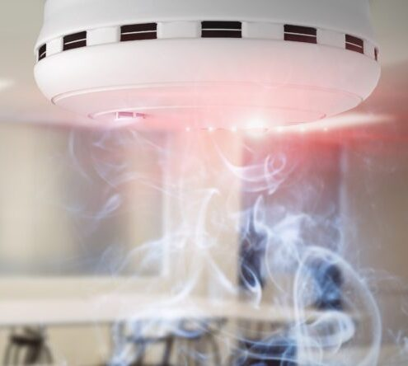
Smoke detectors work by a radionuclide emitting particles which ionise the air.
Which is the best radionuclide to use for this purpose and why?

Slide 6
5 points
3 points
1 points
Americium-241
Radium-226
Californium-252
Thorium-232
Uranium-235
Uranium-238
Notes:
Plutonium-241, Thorium-232, Californium-252
Americium-241- used IRL
Radium-226 – suitable half life, solid, alpha,
Cf-252 – alpha, solid, suitable half life but expensive
Th-232 – alpha, solid, but long half life
U-235/238 – alpha, solid, long half lives, 235 could be used in weapons
Ideal RNs: solid, half life of years, alpha emitter, Pu not used as could be gathered up and used in a weapon(!!!!!!)

Slide 7
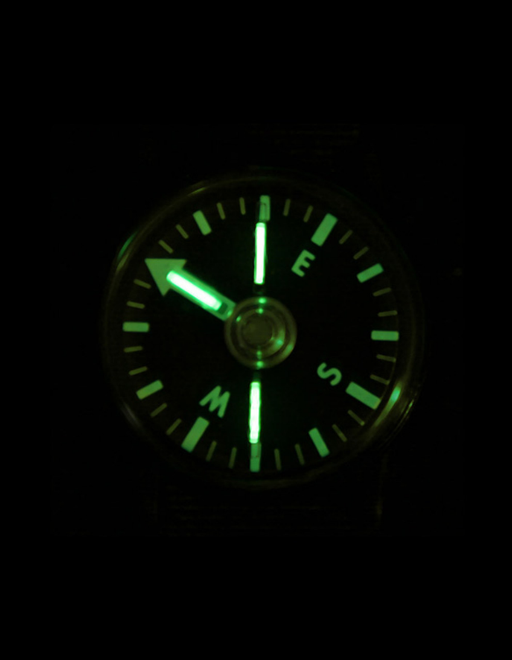
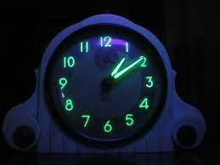
Certain radionuclides release particles during decay, triggering a chemical reaction upon contact with other materials and creating a ‘glow’. This reaction is known as radioluminescence.
You are travelling on a research expedition to the Arctic Circle where it is dark 22 hours of the day in winter. You require a compass that can be read easily, which radionuclide would you use for this purpose and why?

Slide 8
5 points
3 points
1 points
Tritium
Promethium-147
Radium-226
Potassium-40
Lead-210
Nickel-63
Notes:
Tritium- used IRL
Radium-226 – solid, alpha
K-40 – solid, beta, cheap, long half life
Pb-210 – solid, alpha, cheap, suitable half life but poisonous
Ni-63 – solid, beta, long life life
Ideal RN: solid, alpha or beta emitter, cheap, half life of years,

Slide 9
Medicine
Questions

Slide 10
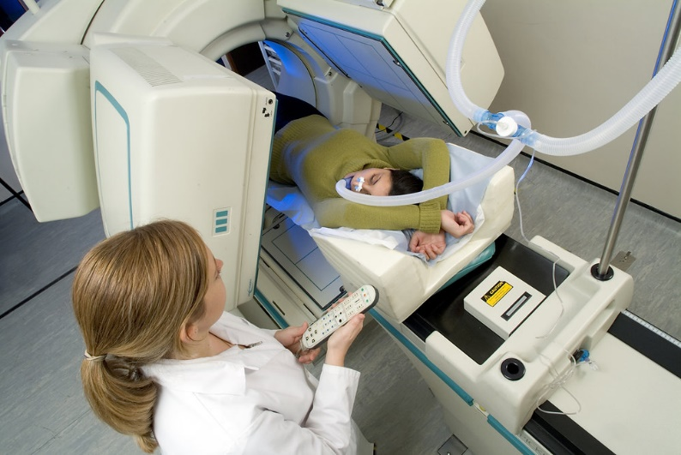
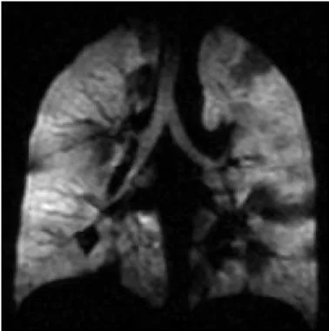
Diagnostic techniques in nuclear medicine use radiopharmaceuticals (or radiotracers) which emit particles or rays from within the body.
These tracers are generally short-lived isotopes, and their emissions are detected by the imaging device.
A patient needs to have the gas exchange in their lungs investigated, which radionuclide would you use for these investigations and why?

Slide 11
5 points
3 points
1 points
Xenon-133
(used in real life; can be breathed in, beta + gamma)
Phosphorus-32
Iodine-131
(decays to xenon-131, half-life 8 days)
Technetium-99m
Notes:
Xe-133 – used IRL
P-32 – beta, cheap, suitable half life but solid
I-131 – suitable half life but solid, decays to xenon
Tc-99m – suitable half life but solid
Ideal – gas, beta +/- gamma, half life of hours/days/months, cheap

Slide 12
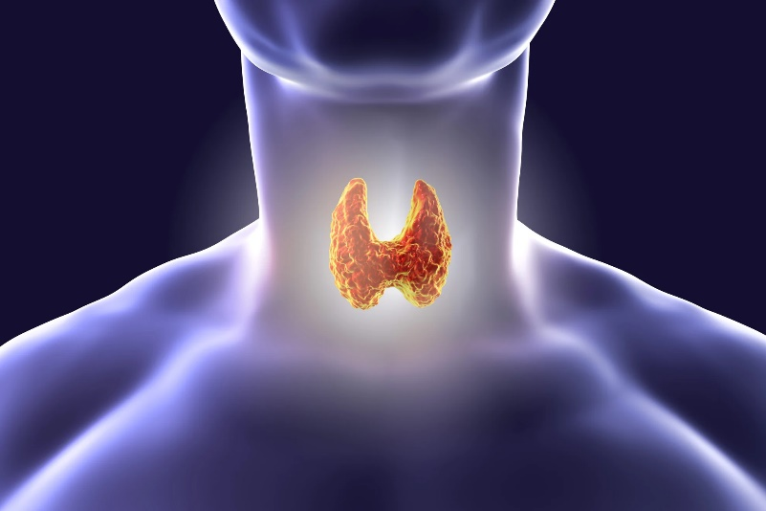
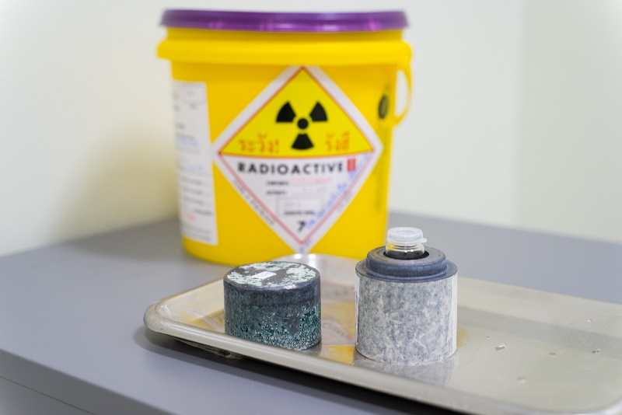
Nuclear medicine is also used for therapeutic purposes.
Which radionuclide would you use to treat a cancerous tumour affecting the thyroid gland?
Please explain your choice!

Slide 13
5 points
3 points
1 points
Iodine-123
Iodine-131
Notes:
I-123 and 131 – concentrate in the thyroid, solid, suitable half life
Ideal – concentrates in thyroid, solid or liquid, half life of hours/days/weeks

Slide 14
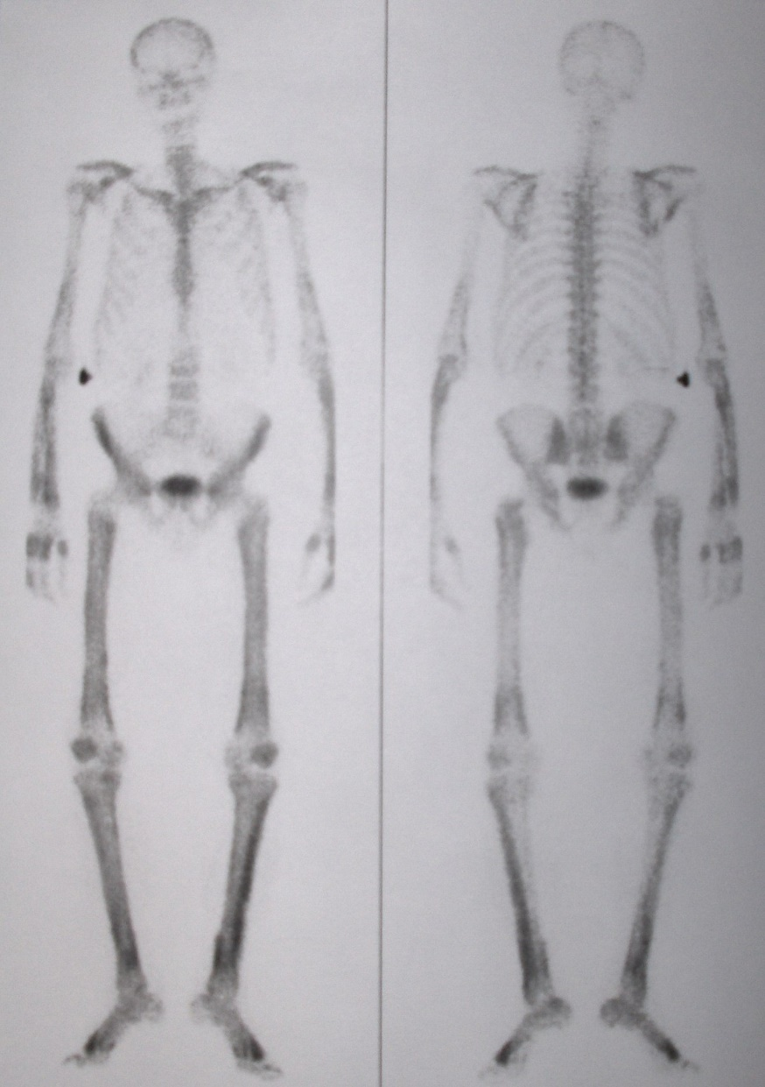
With any therapeutic procedure, the aim is to confine the radiation to well-defined target volumes of the patient.
There are several radionuclides that are used for the relief of cancer-induced bone pain.
Which radionuclides would you use to target cancerous growths in the bone and why?

Slide 15
5 points
3 points
1 points
Calcium-47
Samarium-152
Yttrium-90
Caesium-137
Strontium-90
Notes:
Ca-47 – easily absorbed by bone, beta, solid, suitable half life, used IRL
Sm-152 – suitable half life, beta, solid
Y-90 - easily absorbed by bone, solid, beta, cheap(ish) but more suited for treating for blood cancers
Cs-137 – solid, beta, suitable half life but not easily absorbed by bone
Sr-90 - easily absorbed by bone, solid, beta, cheap but high environmental impact
Ideal – beat +/- gamma, can be absorbed by bone, solid or liquid, half life of days/weeks/months, cheap and natural

Slide 16
Nuclear Power
Questions

Slide 17
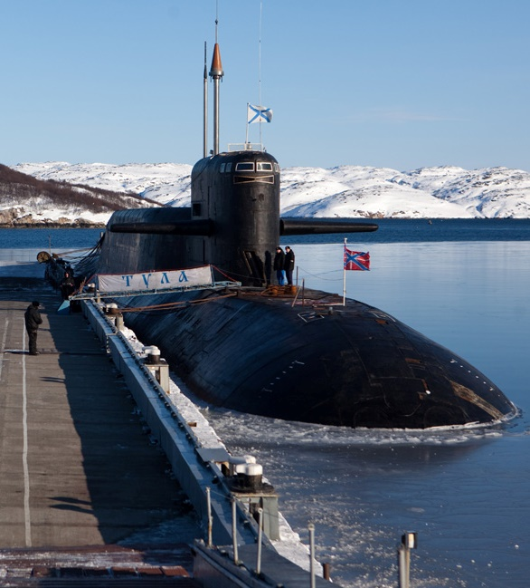

Nuclear power is particularly suitable for vessels which need to be at sea for long periods without refuelling, or for powerful submarine propulsion.
Which radionuclide would you chose to power a submarine and why?

Slide 18
5 points
3 points
1 points
Thorium-232
Uranium-235
Plutonium-239
Uranium-238
Americium-241
Notes:
Th-232 and U-238 – Used IRL
Pu-239, solid, suitable half life but expensive and less conventionally used than Th-232 and U-235
U-238 – solid, suitable half life but not conventionally used in reactors
Am-241 – solid, suitable half life but expensive
Ideal – solid, half life of many years, cheap, large relative atomic mass

Slide 19


Radioisotope Thermoelectric Generators (RTGs) have been used as an electricity source in spacecraft since 1961 due to their high decay heat and short range of particle emissions.
You are in charge of selecting an appropriate radionuclide to power a 50-year satellite Mars mission, which radionuclide do you choose to power your satellite and why?

Slide 20
5 points
3 points
1 points
Plutonium-239
Americium-241
Notes:
Pu-239 – used IRL
Americium-241 – solid, alpha + gamma, but longer-than-ideal half life so lots would be needed
Ideal – solid, pure alpha (to avoid irradiating other satellite components), half life of years (but <100 years), cheap, natural

Slide 21
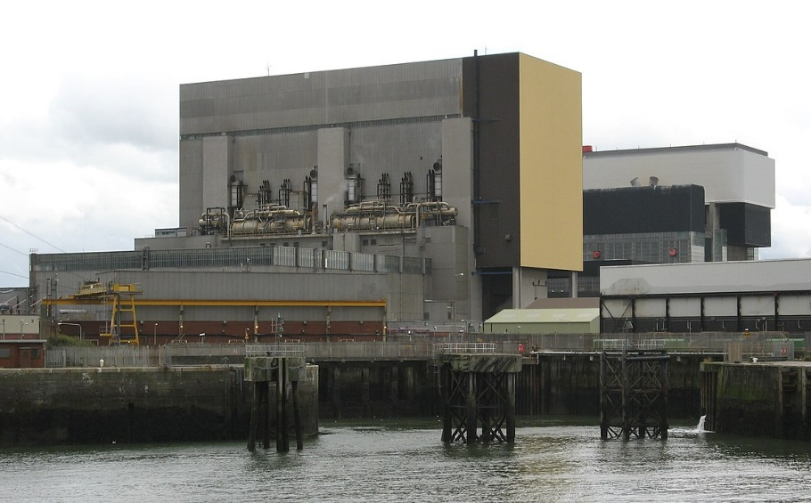
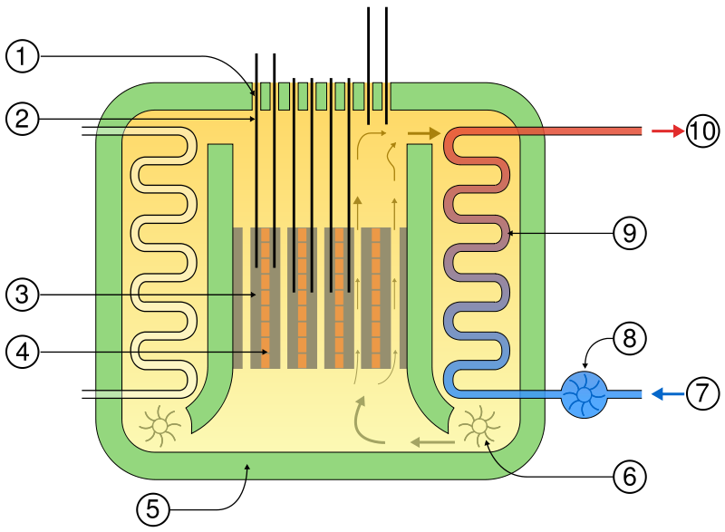
Advanced gas-cooled reactors (AGRs) are the second generation of British gas-cooled reactors.
These reactors, like other nuclear technology, use the energy released by splitting atoms of certain elements.
What is the best radionuclide to use as a fuel for an AGR and why?

Slide 22
5 points
3 points
1 points
Thorium-232
Uranium-235
Plutonium-239
Uranium-238
Americium-241
Notes:
Th-232 and U-238 – Used IRL
Pu-239, solid, suitable half life but expensive and less conventionally used than Th-232 and U-235
U-238 – solid, suitable half life but not conventionally used in reactors
Am-241 – solid, suitable half life but expensive
Ideal – solid, half life of many years, cheap, large relative atomic mass

Slide 23
Science
Questions

Slide 24



Efficient use of fertilisers is a concern to both developing and developed countries.
Fertilisers 'labelled' with a particular isotope provides a means of finding out how much is taken up by the plant and how much is lost into the environment.
Which radionuclide would you use for this purpose and why?

Slide 25
5 points
3 points
1 points
Phosphorus-32
Potassium-40
Calcium-47
Notes:
P-32 – used IRL
K-40 – solid, beta, cheap, natural, low danger and low environmental impact but long half life
Ca-47 – solid, beta, suitable half life, low danger and low environmental impact
Ideal – solid or liquid, beta, half life of days/weeks/months, cheap, natural, low danger and low environmental imapct

Slide 26

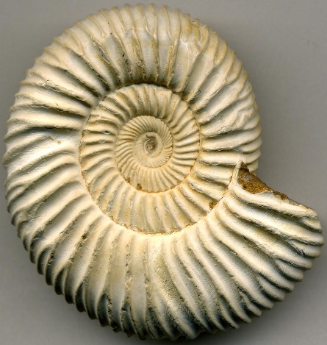
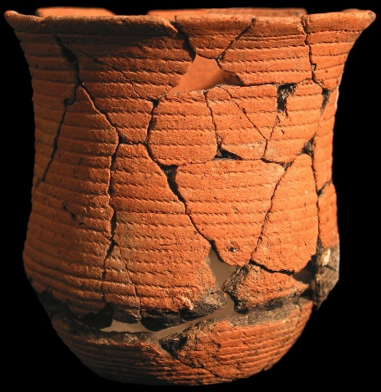
Analysing the relative abundance of particular naturally-occurring radioisotopes is of vital importance in determining the age of rocks and other materials that are of interest to geologists, anthropologists, hydrologists, and archaeologists, among others.
Which radionuclide would you use to measure the age of wood and why?

Slide 27
5 points
3 points
1 points
Carbon-14
Potassium-40
Caesium-137
Lead-210
Notes:
C-14 – used IRL
K-40 –
Pb-210 – Used IRL but not abundant in wood
Cs-137 – Used IRL but not commonly found in wood and not natural,
Ideal – solid, beta +/- gamma, half life of years, natural, abundant in wood

Slide 28
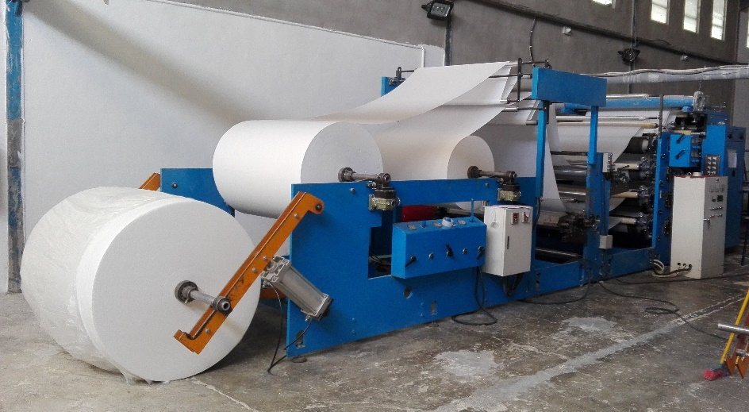
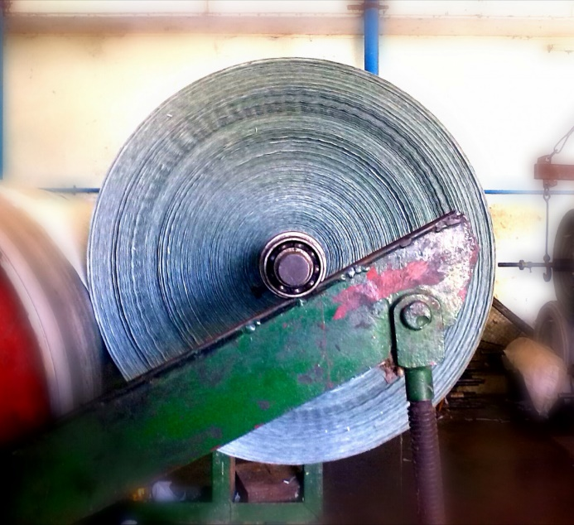
Radioisotopes can be used to accurately measure the thickness of many different sheet materials.
They measure the amount of radiation from a source which has been absorbed in materials.
Which radionuclide would you use to measure the thickness of an extruded metal pipe, why did you choose this radionuclide?

Slide 29
5 points
3 points
1 points
Iridium-192
Iron-55
Nickel-63
Californium-252
Notes:
Ir-192 – used IRL, solid, suitable half life
Fe-55 – solid, suitable half life, cheap
Ni-63 – solid, suitable half life, cheap but high environmental impact
Cf-252 – solid, suitable half life but expensive and high environmental impact
Ideal – solid, beta +/- gamma, low environmental impact and danger, half life of months/years and cheap

